Slide 1




ScrapeEase
MADE BY:
RIYA SINGH
SHIKHAR MISHRA

Slide 2



What is web scraping
Web scraping is the process of extracting real time structured data set from the websites instead of copying and pasting data manually. It helps in gathering large amount of data quickly and efficiently.

Slide 3
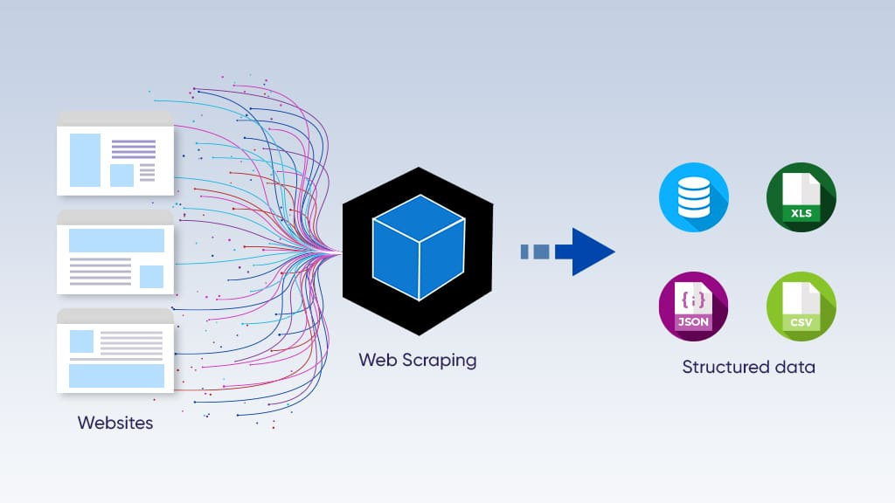
This is how web scraping look likes!
Data can be downloaded in the forms like CSV,
XLSX, JSON, SQL Databases, TXT etc.

Slide 4



PROBLEM STATEMENT
01.
Complexity of Coding
02.
03.
Frequent Website Structure Changes
Error Handling Issues

Slide 5

INTRODUCTION
This project aims to develop an AI-powered web scraping tool that eliminates extra programs. It features automated content detection, adaptability to website changes, and intelligent data parsing, ensuring efficient, accurate, and user-friendly data extraction while reducing time and effort.
.

Slide 6


OBJECTIVE
“No Code Web scraping”
The project develops a no-code AI powered web scraping platform, enabling users to extract structured data effortlessly by entering a URL and a prompt, eliminating coding complexities.

Slide 7

E-commerce Sellers & Retailers
Beginners & Non-
Technical users
Individuals with no programming experience can easily extract data using a simple interface and AI-driven automation.
Monitor product listings, customer reviews, and inventory.
Scope
& features
Structured & Accurate Data
Efficient and User-Friendly
Extracted data is organized into a structured format, ensures well-organized filling in missing values.
Eliminates the need for external tools for complex setups, making it accessible to everyone.

Slide 8


User-Friendly Interface
AI-Driven Web Scraping
Automated Data Parsing & Structuring
Adaptive Scraping Mechanism
Error Handling & Security
Data Export & Review
Scalability & Efficiency
Problem 2
PROPOSED SYSTEM
Solution 2

Slide 9


User-Friendly Interface
The system provides a simple interface where users input a URL and a prompt. No coding knowledge is required, making web scraping accessible to non-programmers while ensuring ease of use and efficiency in data extraction.
AI-Driven Web Scraping
AI algorithms analyze webpage structures to extract data accurately. Unlike traditional scrapers, it can handle dynamic content, including JavaScript-rendered elements, ensuring comprehensive data collection without requiring additional tools like Selenium.

Slide 10


Automated Data Parsing & Structuring
Extracted data is automatically formatted into structured tables, handling missing values and inconsistencies. The AI standardizes the dataset, ensuring uniformity and reliability for further analysis, minimizing the need for manual data cleaning.
Adaptive Scraping Mechanism
Machine Learning models detect website layout changes and adjust scraping logic accordingly. This eliminates the need for frequent script modifications, making the system robust and capable of handling evolving webpage structures.

Slide 11

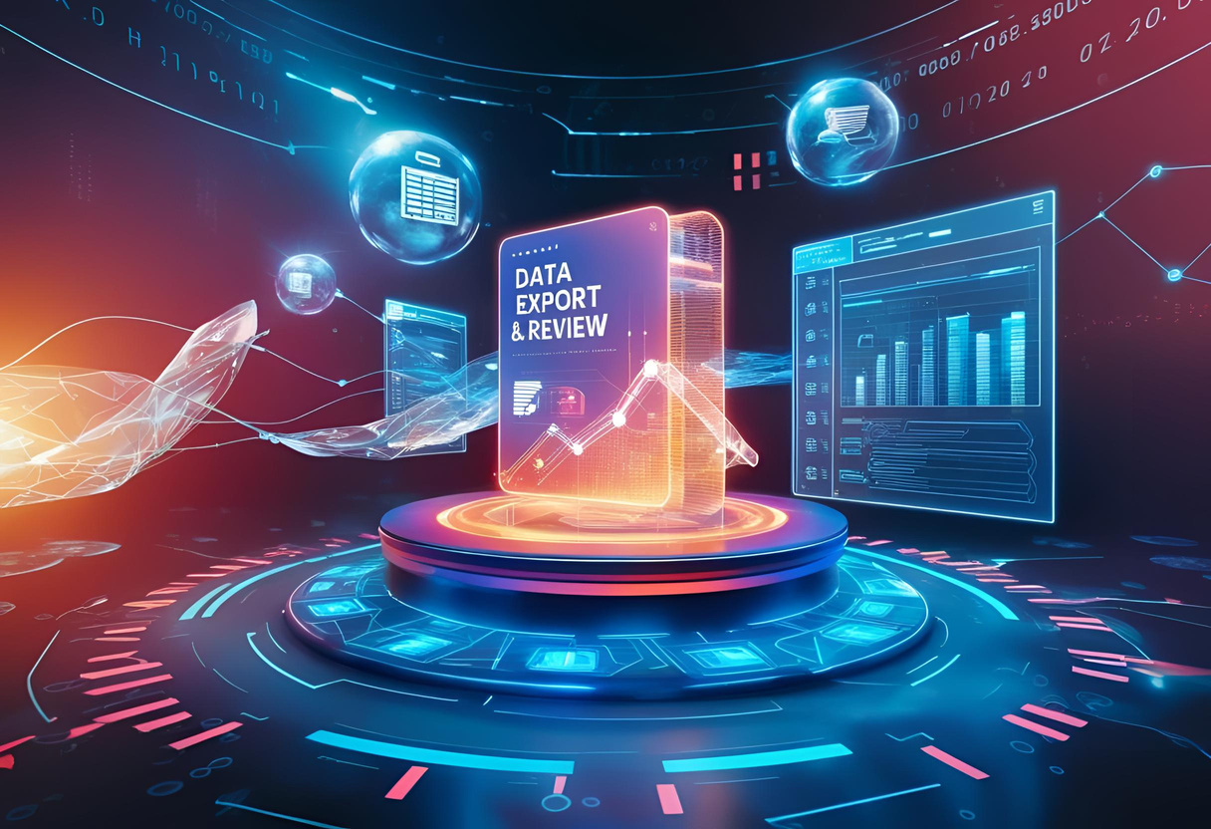
Error Handling & Security
The system identifies and resolves common web scraping errors such as missing fields, blocked access, and CAPTCHA challenges. Basic security measures, including user authentication, prevent unauthorized access and ensure compliance with ethical web scraping practices.
Data Export & Review
Users can preview extracted data before downloading it in various formats such as CSV, JSON, and Excel. This feature ensures data accuracy and allows users to verify extracted content before further processing or analysis.

Slide 12


Scalability & Efficiency
The system identifies and resolves common web scraping errors such as missing fields, blocked access, and CAPTCHA challenges. Basic security measures, including user authentication, prevent unauthorized access and ensure compliance with ethical web scraping practices.

Slide 13

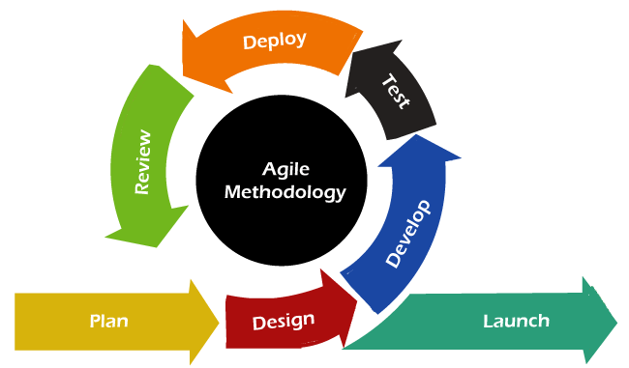
LIFE CYCLE MODEL USED
Agile Model
The Agile Model is an iterative and flexible software development approach that focuses on continuous improvements, user feedback, and adaptability. Instead of a rigid step-by-step process, Agile follows short development cycles called sprints, allowing for quick adjustments based on changing requirements.

Slide 14

Technical Feasibility
Economic Feasibility
The system leverages AI for adaptable web scraping, handling dynamic content and missing values with minimal manual intervention. It ensures scalability and efficient performance using Python, Flask, and machine learning techniques.
Feasibility Study
The project minimizes costs by utilizing open-source tools, reducing manual script maintenance, and offering a potential revenue model through a SaaS-based approach.
Operational Feasibility
Legal Feasibility
A user-friendly interface enables non-programmers to extract data efficiently, while AI-driven automation reduces errors and enhances adaptability.
The system must comply with web scraping regulations, adhere to robots.txt policies, and follow ethical data extraction practices to avoid legal risks.

Slide 15
RESOURCES (HARDWARE & SOFTWARE)
HARDWARE REQUIREMENT
CLIENT SIDE
DEVELOPER SIDE
PROCESSOR | DUAL CORE OR ABOVE
RAM | MIN 4 GB
DISK SPACE | 150 GB
MONITOR | 720P
OTHERS | KEYBOARD, MOUSE, INTERNET CONNECTION
PROCESSOR | · QUAD CORE OR ABOVE
RAM | 8 GB
DISK SPACE | 250 GB
MONITOR | 1080P OR ABOVE
OTHERS | KEYBOARD, MOUSE, INTERNET CONNECTION

Slide 16

2. SOFTWARE REQUIREMENTS
CLIENT SIDE:
· Web BrOWSER (GOOGLE CHROME, FIREFOX, IE9 OR ABOVE)
· WINDOWS 7 OR ABOVE / LINUX / ANDROID / IOS
DEVELOPER SIDE:
OPERATING SYSTEM: WINDOWS 10 OR ABOVE /LINUX
WEB BROWSER: CHROME / FIREFOX / EDGE
IDE: VS CODE
PROGRAMMING LANGUAGE: PYTHON
RUNTIME ENVIRONMENT: MINICONDA3
BACKEND FRAMEWORK: FLASK
DATABASE: SQL ALCHEMY
VERSION CONTROL SYSTEM: GIT

Slide 17
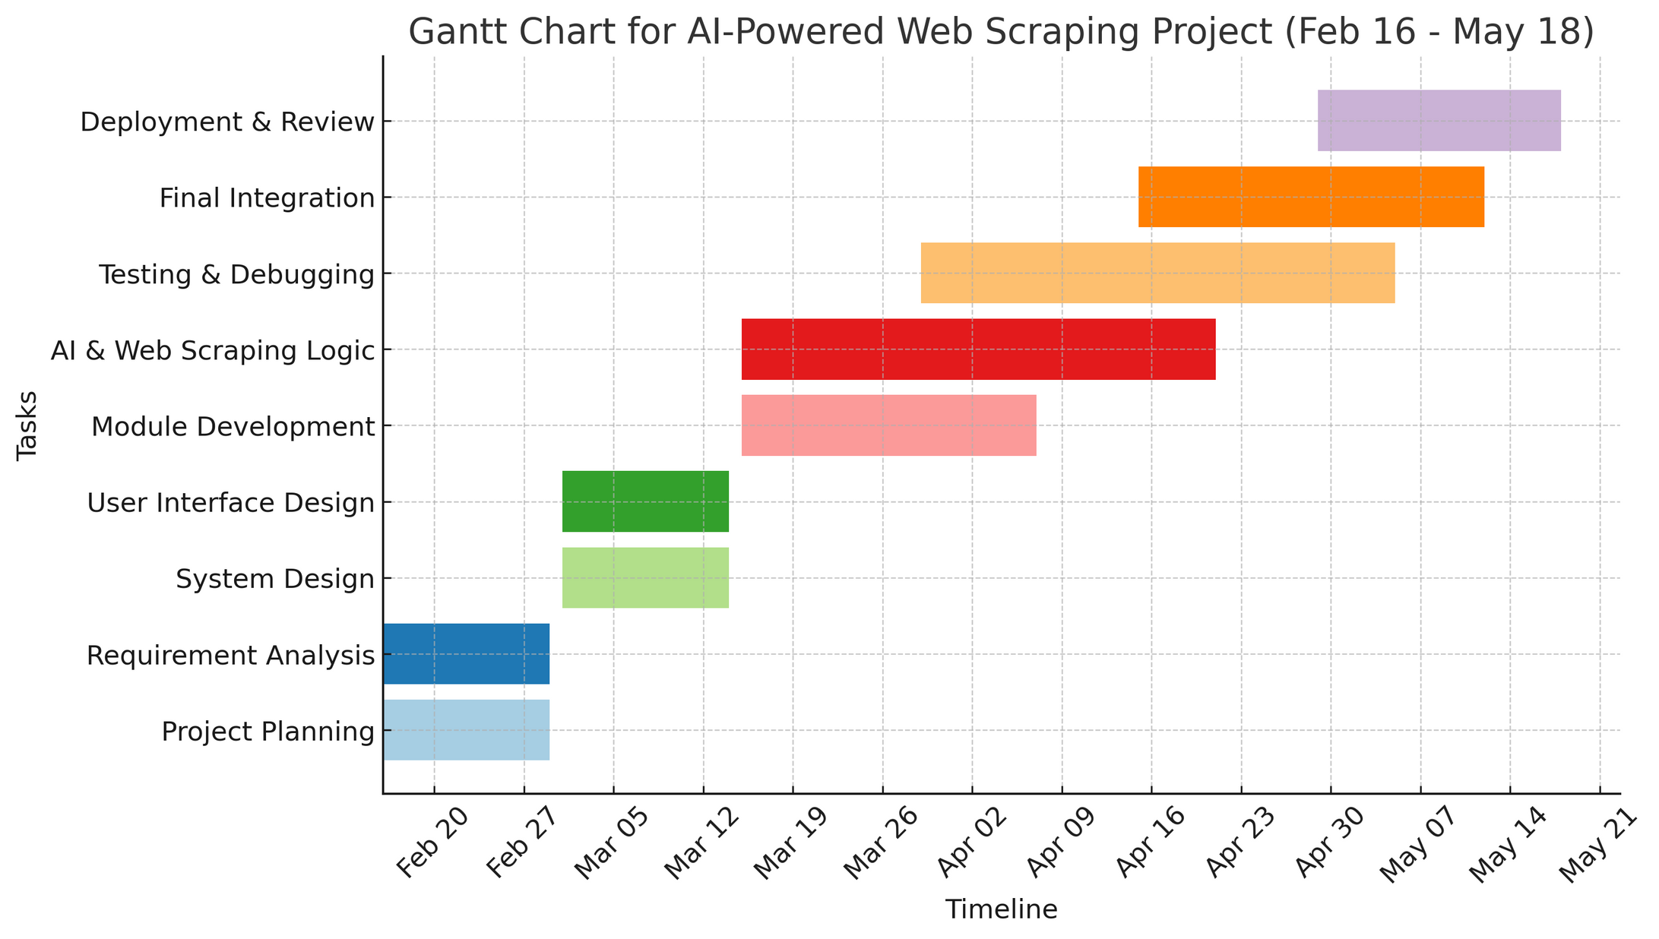
GANTT CHART

Slide 18

Unified Modeling Language Diagrams

Slide 19


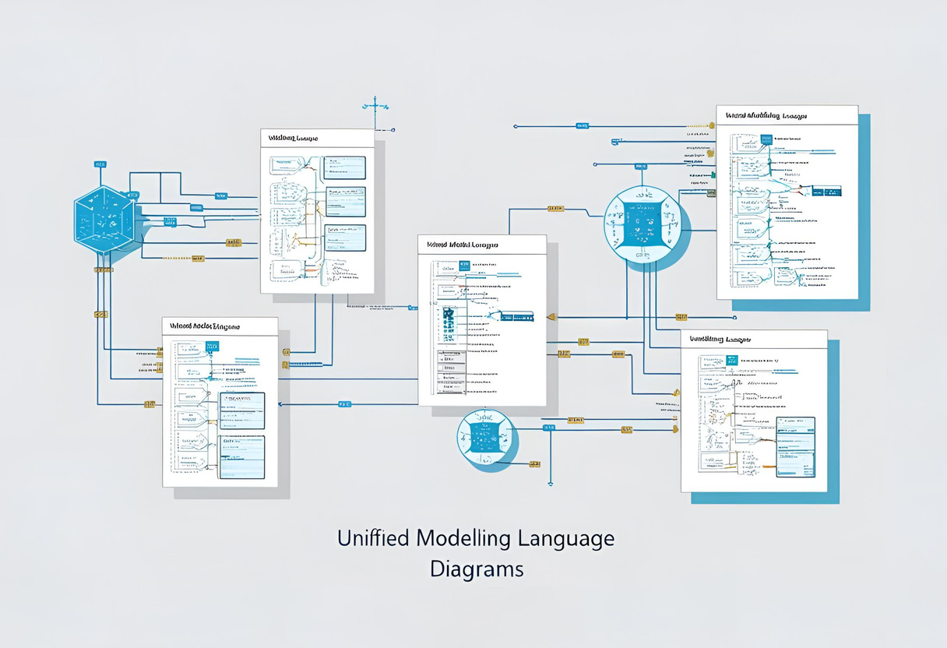
Unified Modeling Language Diagrams
A UML DIAGRAM IS A DIAGRAM BASED ON THE UML (UNIFIED MODELING LANGUAGE) WITH THE PURPOSE OF VISUALLY REPRESENTING A SYSTEM ALONG WITH ITS MAIN ACTORS, ROLES, ACTIONS, ARTIFACTS OR CLASSES, IN ORDER TO BETTER UNDERSTAND, ALTER, MAINTAIN, OR DOCUMENT INFORMATION ABOUT THE SYSTEM.

Slide 20
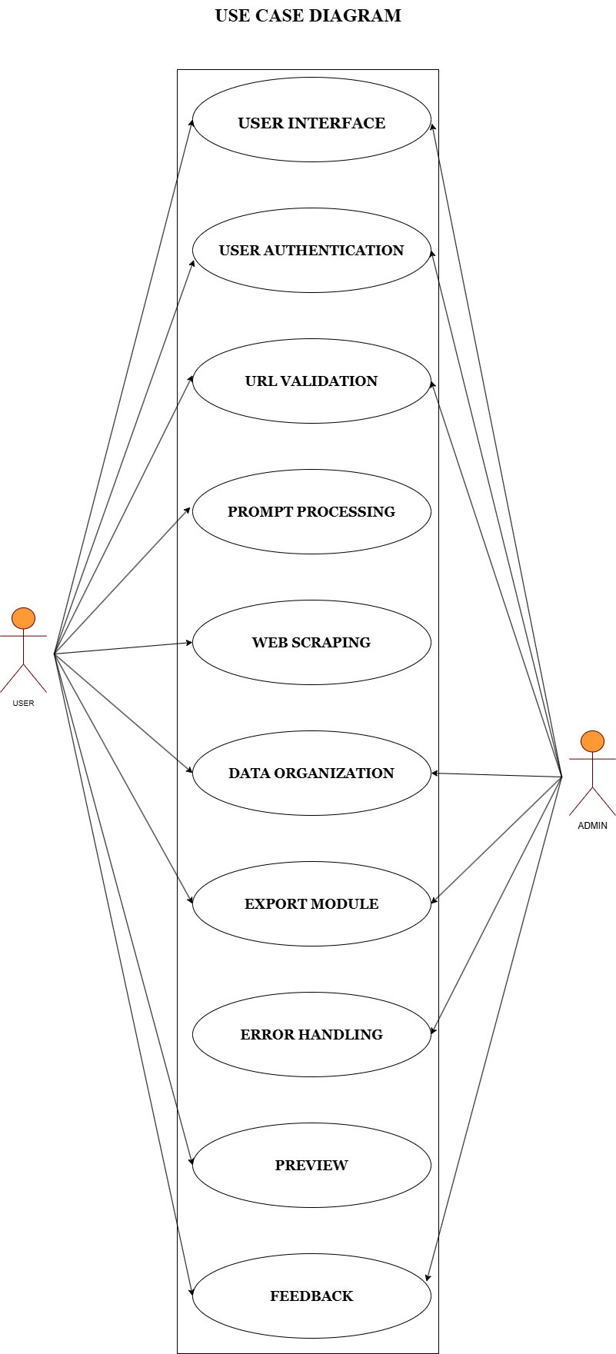

Slide 22
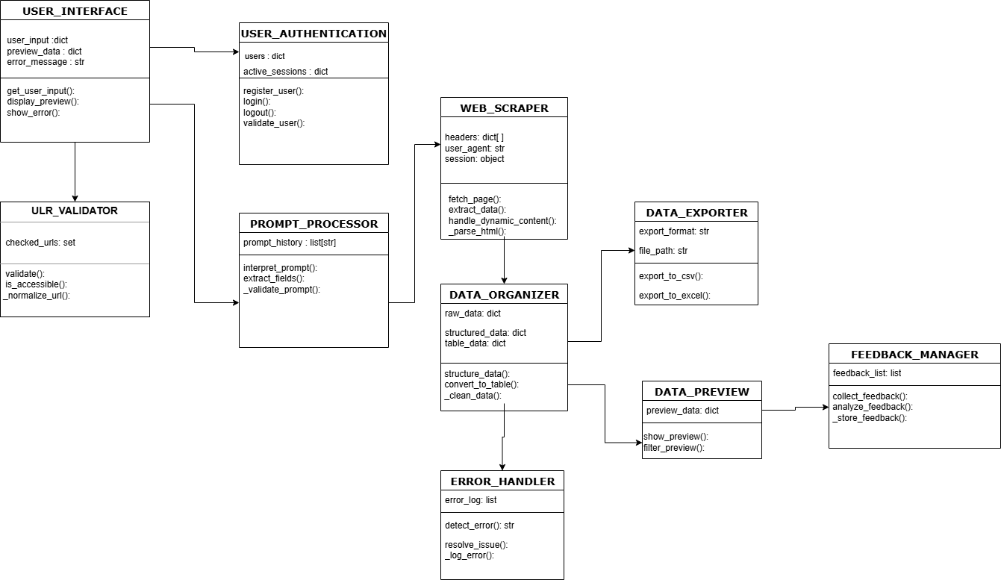
class diagram

Slide 23
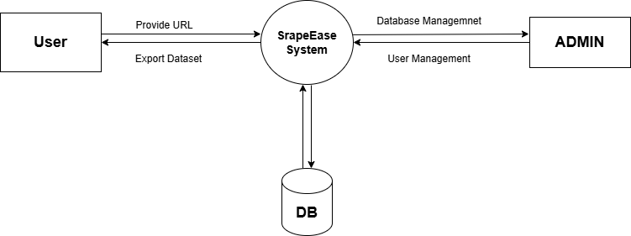
Data Flow Diagram

Slide 24

Modules Description

Slide 25


User Authentication Module
User Interface Module
This module provides a simple, interactive interface where users enter a URL and prompts for data extraction. It ensures ease of use, making web scraping accessible to non-programmers while streamlining the overall user experience.
Ensures secure access by managing user login and registration. It prevents unauthorized usage, protecting extracted data and system integrity. The module implements encryption and authentication mechanisms to maintain security and privacy for all users interacting with the platform.

Slide 26

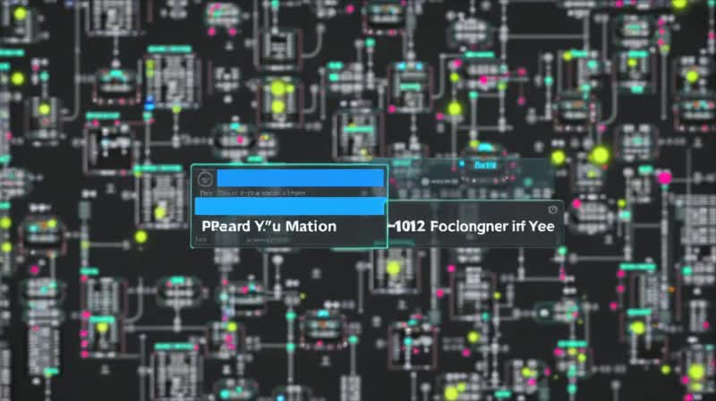
URL Validation Module
Checks whether the entered URL is valid, accessible, and follows ethical scraping guidelines. It prevents errors caused by incorrect or blocked URLs and ensures the system adheres to website permissions and robots.txt policies.
Prompt Processing Module
Interprets user-entered prompts to identify and extract relevant data fields. It ensures AI-based filtering, focusing only on requested information, thus improving efficiency by avoiding unnecessary data retrieval from web pages.

Slide 27


Web Scraping Module
Data Organization Module
Uses AI-powered algorithms along with tools like BeautifulSoup and Selenium to extract structured data from both static and dynamic web pages. It adapts to website changes, ensuring continuous and accurate data retrieval without manual intervention.
Formats and structures the extracted data into a clear, tabular format for easy analysis. It eliminates duplicates, corrects inconsistencies, and ensures well-organized, accurate, and readable output for better usability.

Slide 28
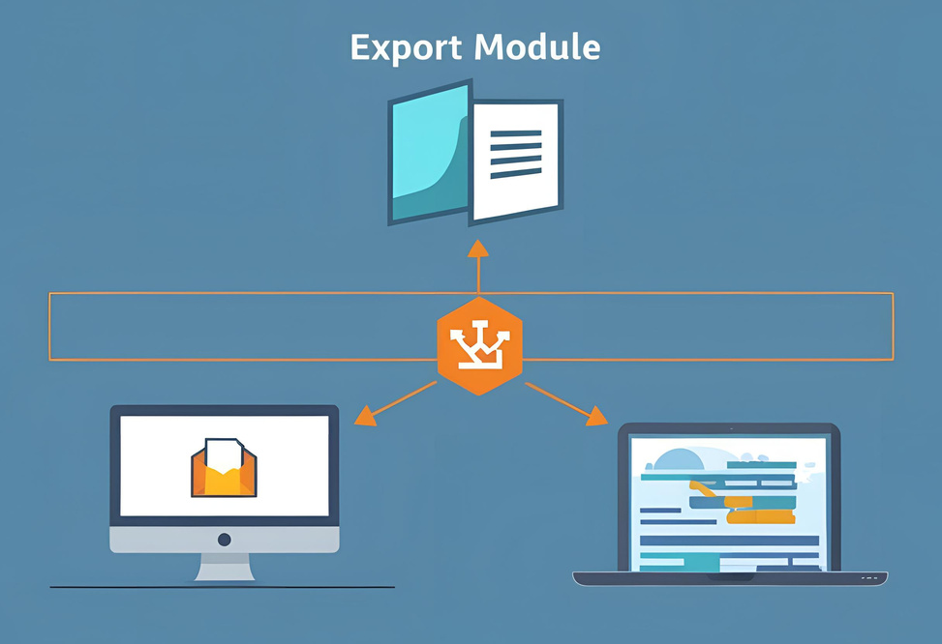
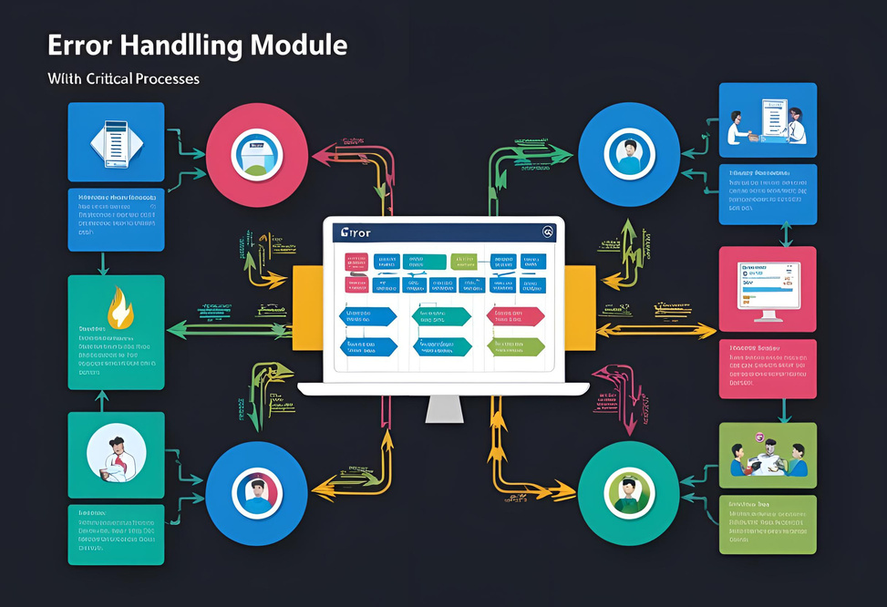
Export Module
Error Handling Module
Allows users to download extracted data in multiple formats such as CSV, JSON, and Excel. It ensures flexibility, enabling seamless integration with external databases, analytics tools, or business applications for further processing.
Detects and resolves issues like website changes, missing data, blocked access, and CAPTCHAs. It includes retry mechanisms and alternative extraction techniques to ensure smooth functionality without disruptions due to technical failures.

Slide 29
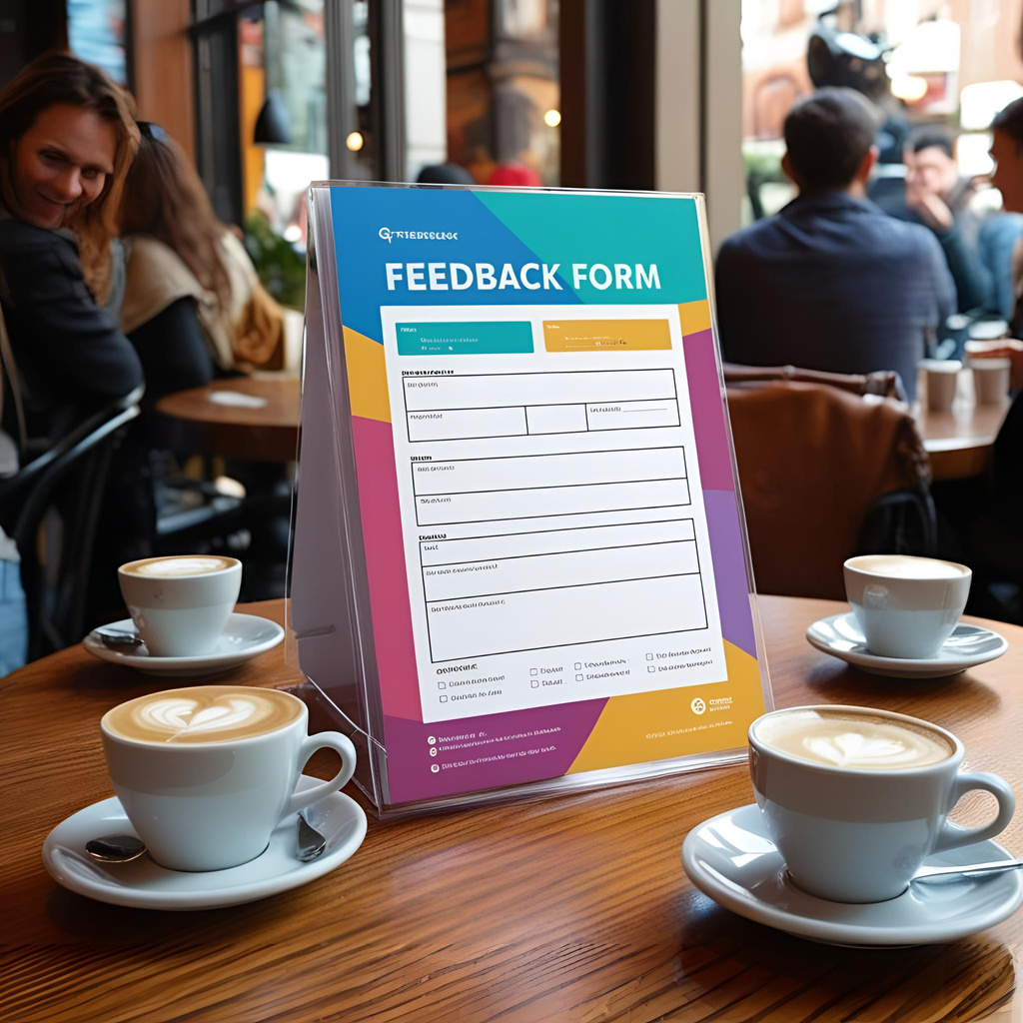

Preview Module
Feedback Module
Collects user feedback on extraction quality and system performance. It helps improve AI algorithms and enhance future web scraping accuracy, ensuring continuous optimization and adaptation to changing website structures.
Displays extracted data before download, allowing users to review and verify accuracy. This module ensures users get only relevant and well-structured data, reducing the need for manual corrections after extraction.

Slide 30
Attached Screenshots
for your refrence.

Slide 31
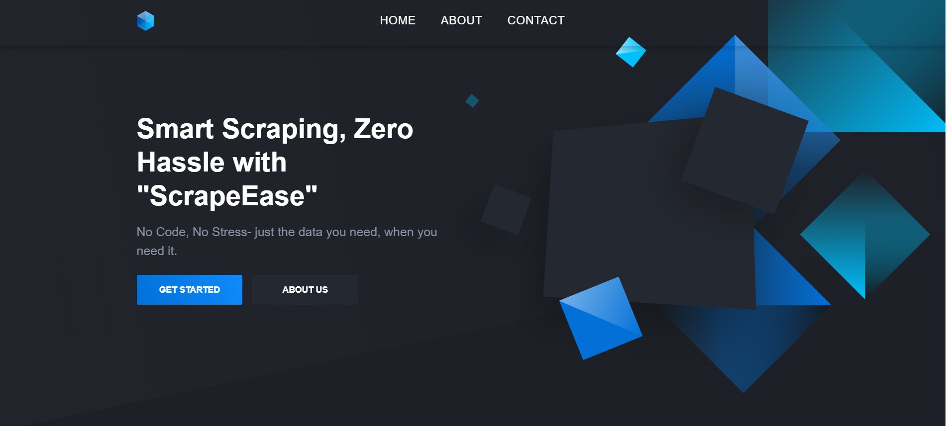
Landing Page

Slide 32
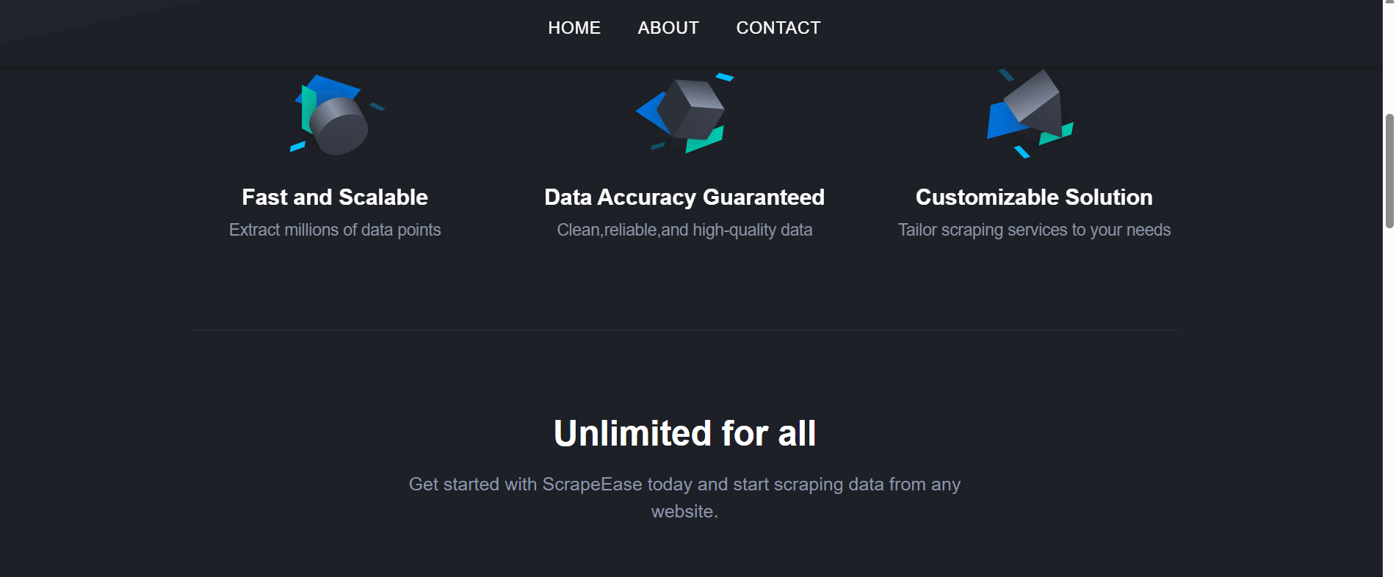

Slide 33
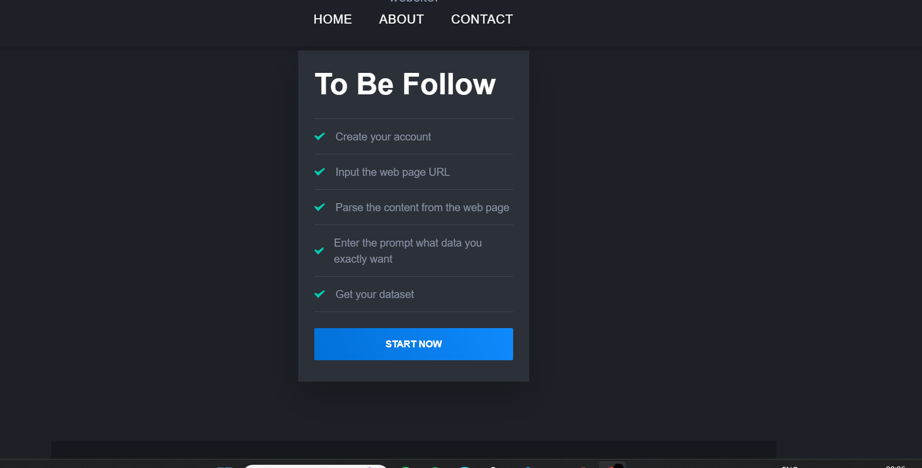

Slide 34
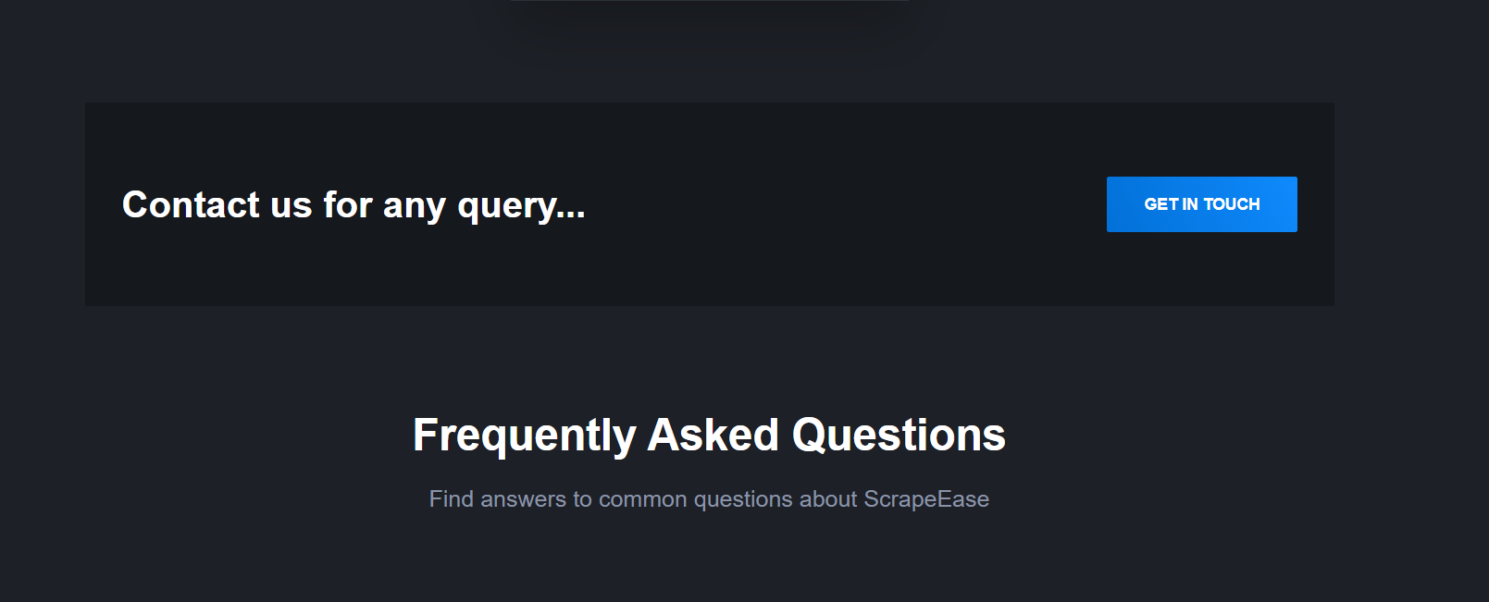

Slide 35
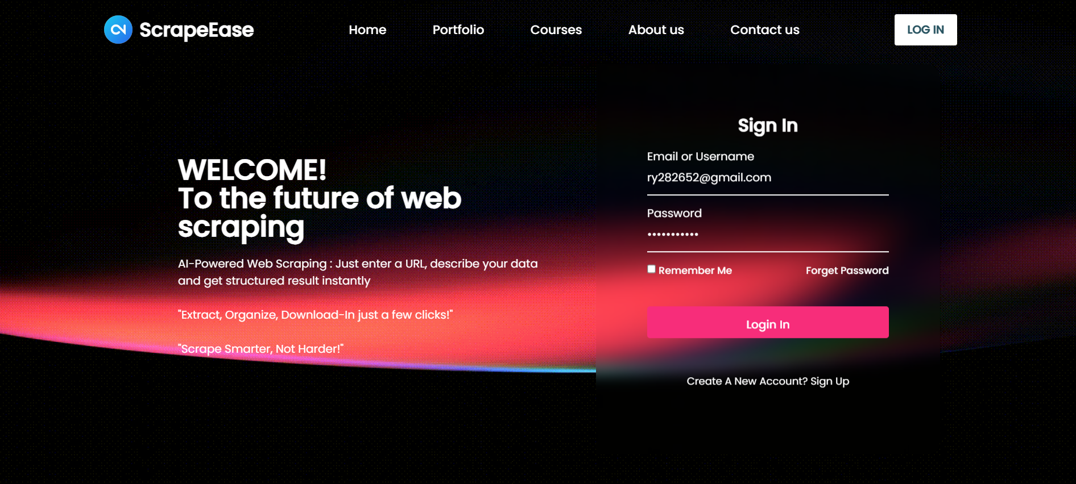
Login Page

Slide 36
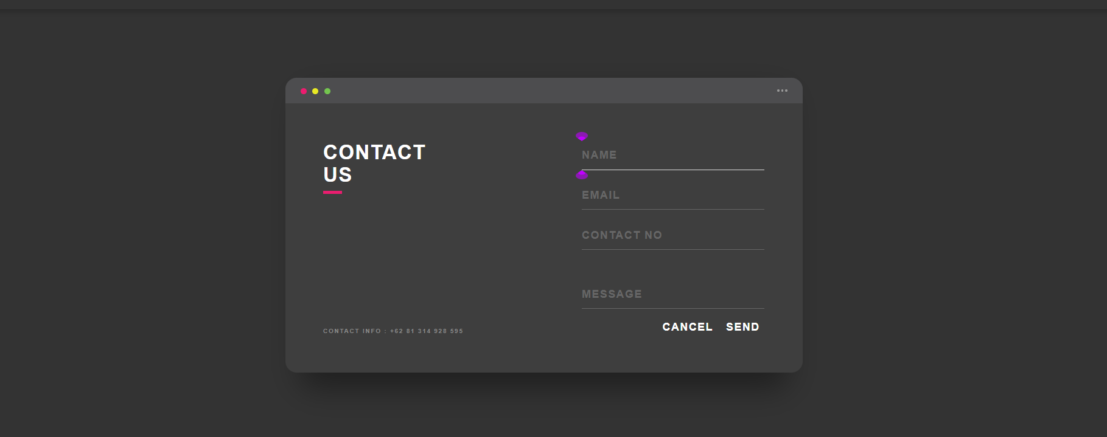
Contact Us page

Slide 37



CONCLUSION
The AI-powered web scraping platform simplifies data extraction by eliminating coding complexities. It ensures adaptability, accuracy, and efficiency through machine learning. With a no-code approach, automation, and scalability, it makes web scraping accessible, reliable, and future-ready. 🚀

Slide 38
